Slide 1
The Economy and Steel in 2020
February 7, 2020
John Anton
Associate Director +1 202 481 9231 john.anton@ihsmarkit.com

Slide 2
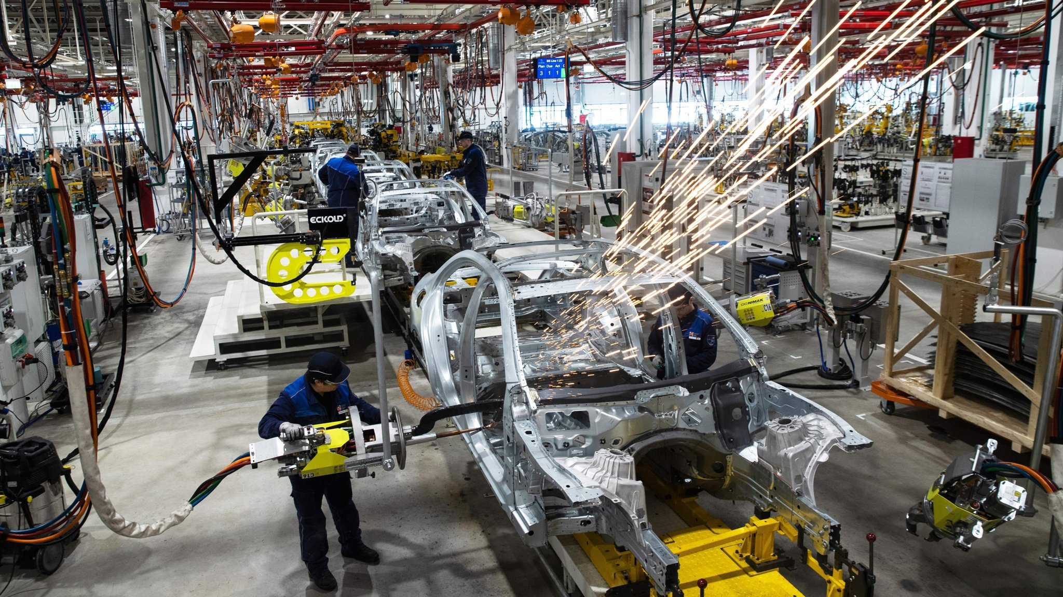
Overview
No global recession, but weak growth
US growth will trend around 2.0%
Boeing 737 production halt will lower GDP growth by as much as 0.5 percentage point in Q1
Fed will remain on hold; other central banks will ease more
US$ will remain strong
It has eased slightly in the past month, however, suggesting a more risk on view of the near future among investment managers
Commodity prices will fall slightly in 2020 – due to oil and iron ore
More broadly a subtle change will be evident in supply chains by 2020H2

Slide 3
A severe scenario, quantifying the impact of a prolonged shutdown in China
Coronavirus Webcast: Key Regional and Industry Economic Impact I 5 February 2020
Confinment measures are assumed to stay in place until the end of February 2020, before being lifted progressively.
Plants stay closed until end of February, a 5 week stop instead of the usual 10 days.
Financing conditions for companies and households are eased but NPL nonetheless increased.
Personal consumption expenditures fall severely in Q1, investment resists better.
Tourism activity in China and abroad is severely curtailed.
Oil prices and other commodity prices come down due to the collapse in demand from a key end-user. Brent oil prices assumed to fall to 55 $/bbl in 2020 Q1.
China lets the RMB depreciate against the dollar by 3-5% in the short-term, then the exchange rate moves back progressively.

Slide 4
The pandemic will have significant economic consequences
Coronavirus Webcast: Key Regional and Industry Economic Impact I 5 February 2020
Impact on China
Impact on the rest of world
Confinement of millions of inhabitants in several cities
Collapse of activity related to retail, hotels, restaurants, entertainment and travel
Extension of the New Year « holiday » halting industrial production and service activities
Fall in tourism revenue, cancellation of flights, hotel nights etc
Impact on energy and commodity prices, and on the fall in demand from China and Asia
Fallout of the precautionary measures

Slide 5
Impacts are significant at industry level, with machinery and equipment, food, iron and steel, and motor vehicles posting the largest drops in VA in mainland China
Coronavirus Webcast: Key Regional and Industry Economic Impact I 5 February 2020

Slide 6
By mid year 2020, several key sectors post much lower real value added, both in mainland China and in the rest of Asia
Coronavirus Webcast: Key Regional and Industry Economic Impact I 5 February 2020
Source: IHS Markit

Slide 7
Steel outlook – Nothing to get excited about. Sorry.

Slide 8
Takeaways for steel
We are at or past the bottom on prices.
Supply is good but surplus is shrinking globally
Demand is improving but spotty
It is not strong enough to create shortages or justify price hikes
Trade is an unknown. To be safe, plan for status quo

Slide 9
Carbon steel

Slide 10
Takeaways for steel – Lock now
We are at or past the bottom.
Prices rise through 2020, but the uptrend is mild.
Lower average prices in 2020 than 2019
Sheet dropped back after over-rapid December-January hikes
Any big hikes will fail.
Demand is improving but spotty
It is not strong enough to create shortages or justify price hikes
Supply risk is elevated from coronavirus
Wuhan will make less steel, but also consume less steel. Which will be larger?
Certain that iron ore consumption will be off
Trade is an unknown. To be safe, plan for status quo
We are planning on tariffs now lasting indefinitely
Recent expansion is a non-event, unless it is a toe in the water for more to come

Slide 11
Raw materials – big 2018-19 drops, noticeable rebound in scrap
Raw materials retreated across 2018-2019
Make sure you get lower surcharges in 2020
Scrap fell too far, is now rebounding
Upside is limited
Do not let mills over-promote
Iron ore has only partially retreated
Fundamentals say more downside
Temporary stability as Chinese mills restock

Slide 12
Sheet – Now is the time to buy
Buy sheet now
Sheet is the easiest product to give advice on
Prices starting to rise after sharp 2019 declines
Upside is limited but clear
Consumption is low, but so is inventory
So there is bounce risk despite weak demand
US and Chinese mills are leading the rebound, but there are stirrings in Europe and India
.

Slide 13
Bar more stable in North America; ROW same cycle
Long products never jumped like flats, so less downside pressure
US prices remain about 25% to 30% above Europe
Just covers the Section 232 tariff
Prices are unsettled. Hard to pick up a clear trend
Next moves likely up on the December-January scrap surcharges
But scrap is crashing this week

Slide 14
Risks to the forecast
Most line up to the downside
Tropical Cyclone Damien
Cyclones are the biggest known-unknown for steel, bar nothing
2008 – prices went from $600 to $1200 and cyclones were the only real reason
Damien is big and on a dangerous path.
Certain delay in shipments from Port Hedland
Uncertain damage to mines, rail, and roads
Demand is weaker than expected
East Asia from C virus
USA and Europe from
Disrupted supply chains
General economic malaise

Slide 15
Stay up-to-date on tariffs with IHS Markit
Go to connect.ihs.com and login with your username and password

